Slide 1
Manchester
Raspberry
Jam XVIII
February 2014

Slide 2
Last time…

Slide 3
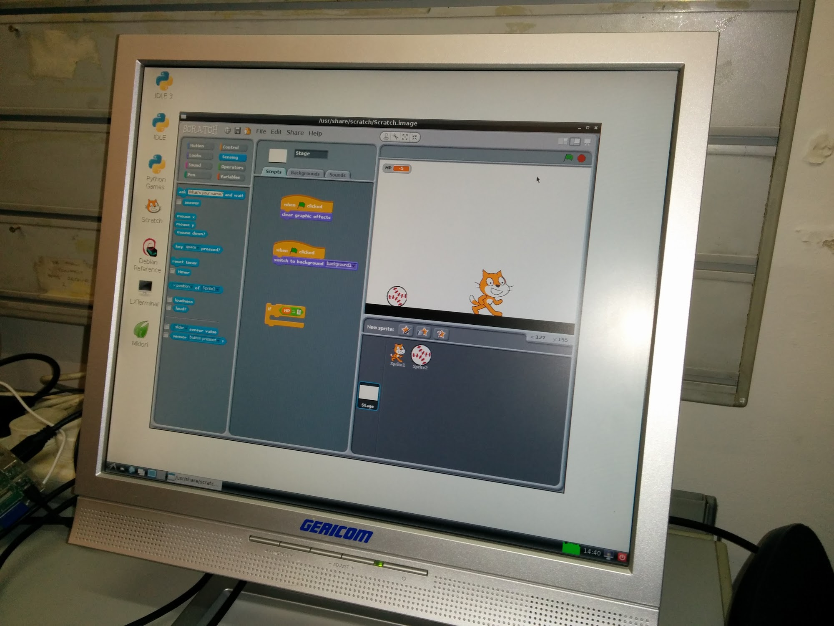
My first time hosting

Slide 4
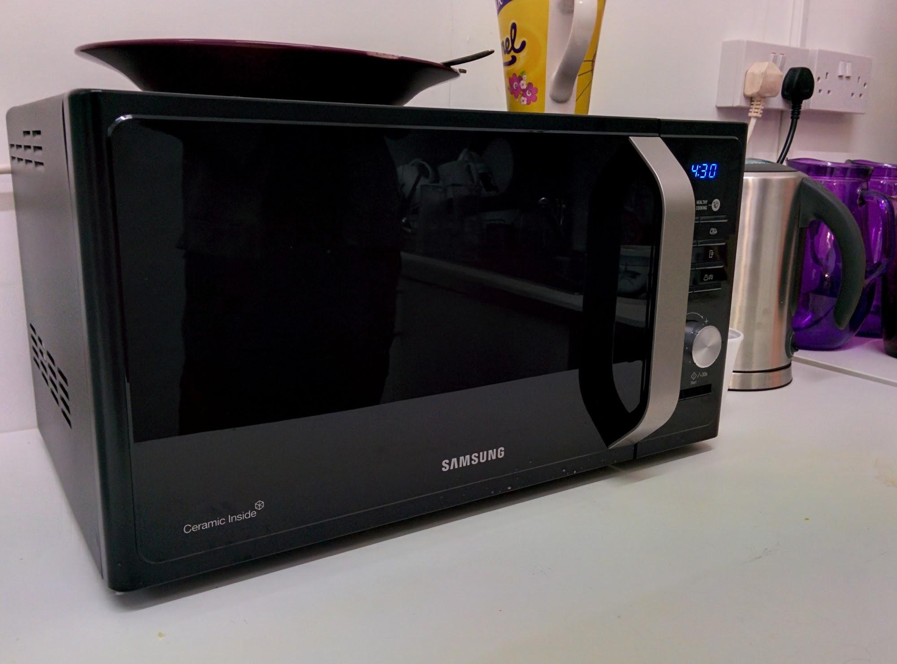
My first time hosting

Slide 5
In other news...

Slide 6
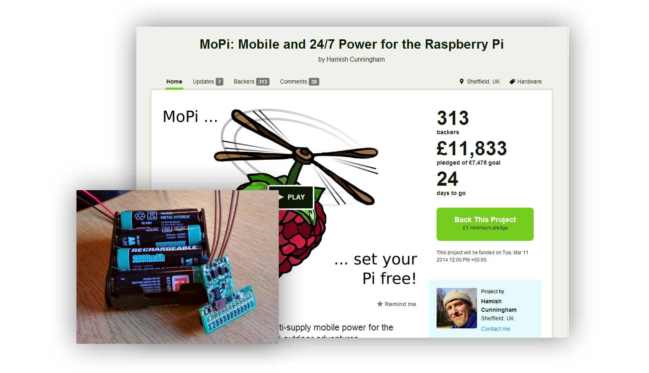
Kickstarter - MoPi
https://www.kickstarter.com/projects/hamishcunningham/mopi-mobile-and-24-7-power-for-the-raspberry-pi

Slide 7
Projects...

Slide 8
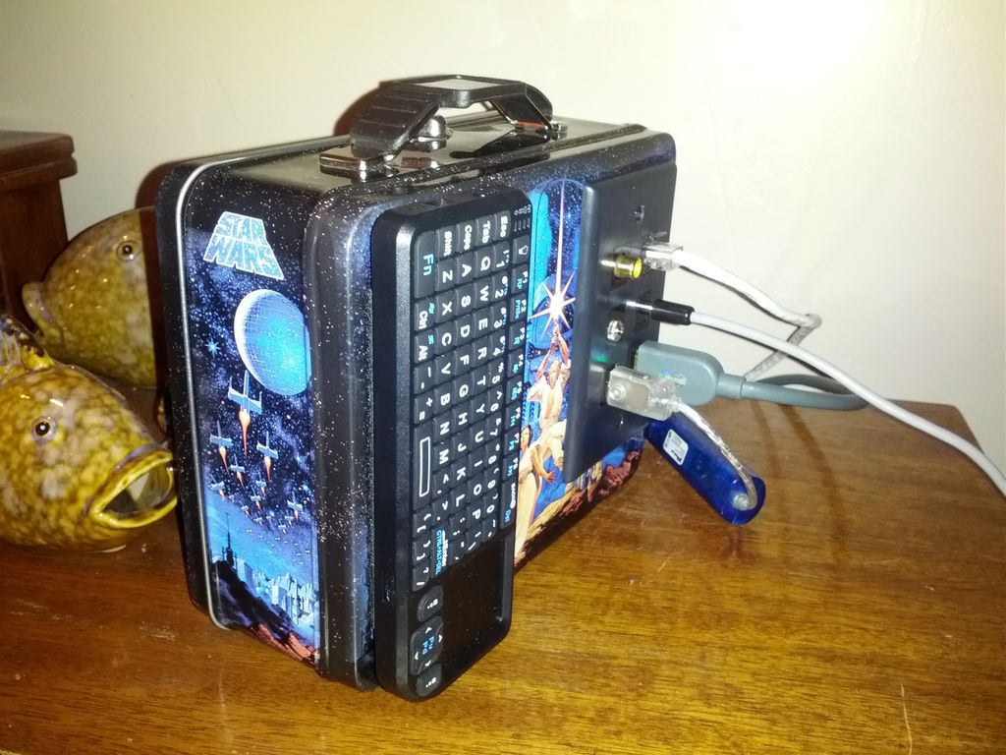
Lunchbox XBMC
http://www.instructables.com/id/Portable-XBMC-Lunch-box/

Slide 9
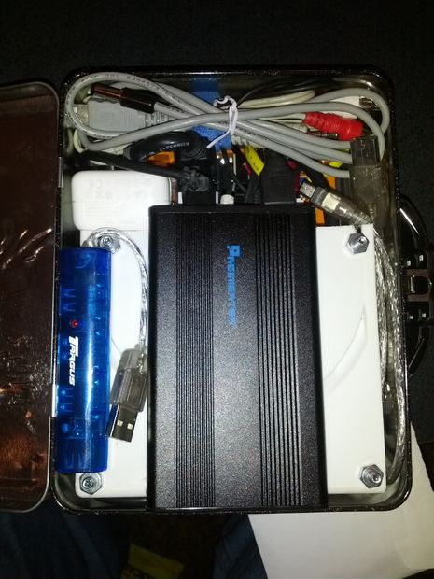
Lunchbox XBMC
http://www.instructables.com/id/Portable-XBMC-Lunch-box/

Slide 10
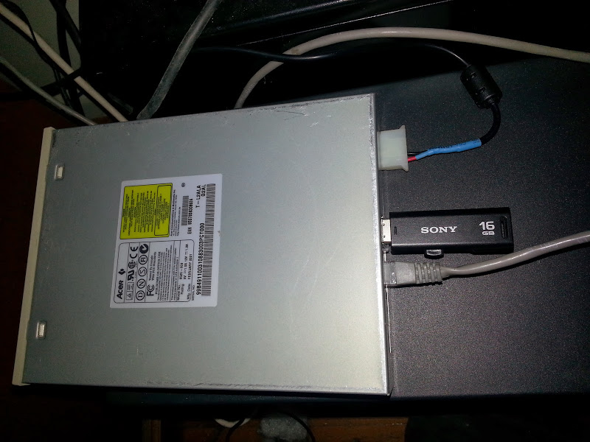
5.25” Raspberry Pi
http://blog.johndroach.com/2014/01/raspberry-pi-cd-rom-case.html

Slide 11
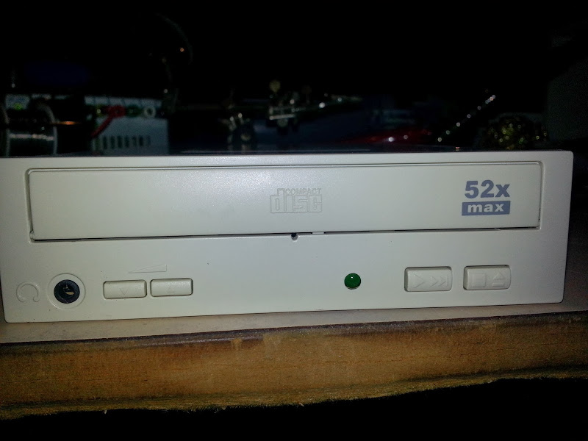
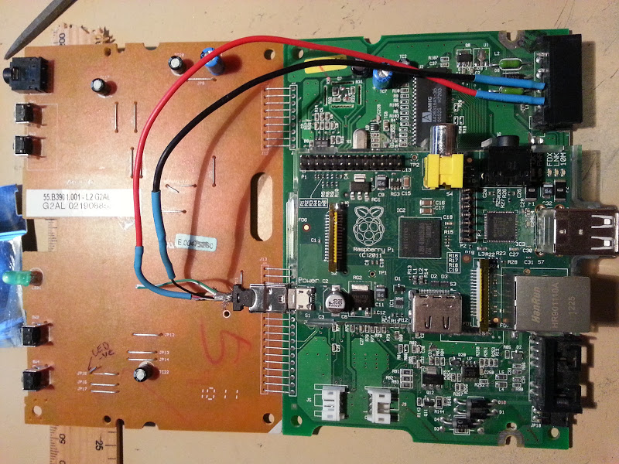
5.25” Raspberry Pi
http://blog.johndroach.com/2014/01/raspberry-pi-cd-rom-case.html

Slide 12
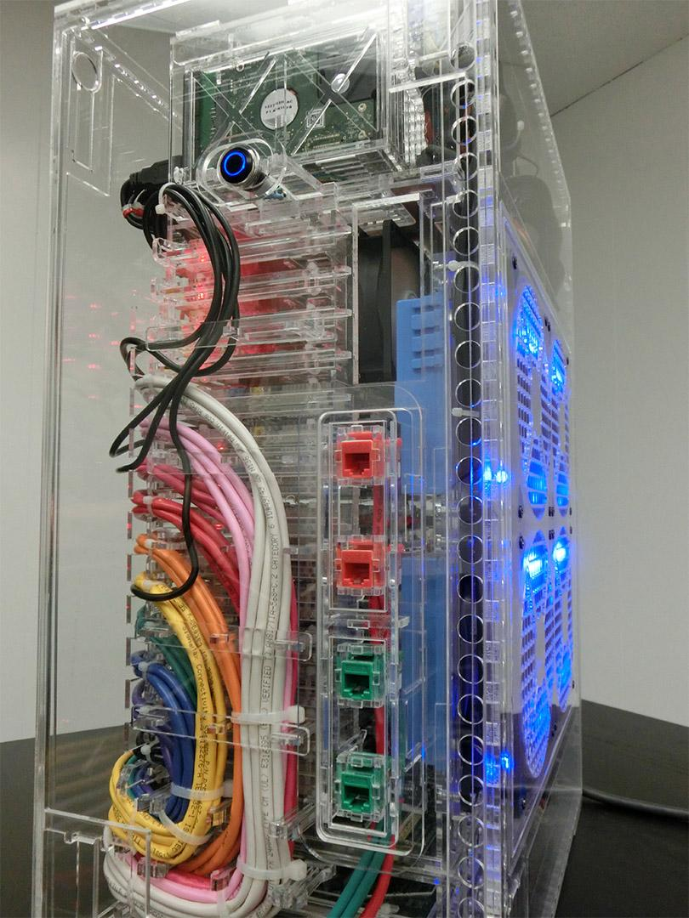
40-Node Pi Cluster
40 Cores @ 700MHz
20GB RAM
5TB Storage (12TB Max)
External Gigabit LAN
Wireless N
Approximate $3000 Cost
http://likemagicappears.com/projects/raspberry-pi-cluster/

Slide 13
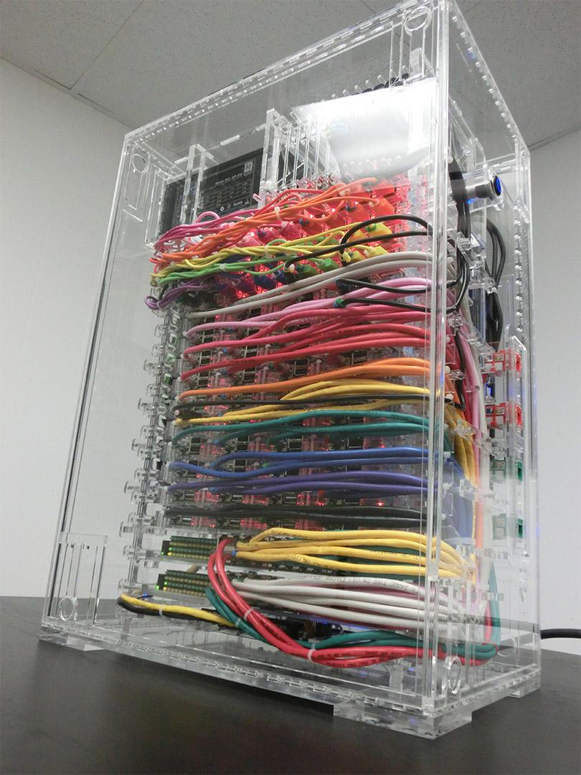
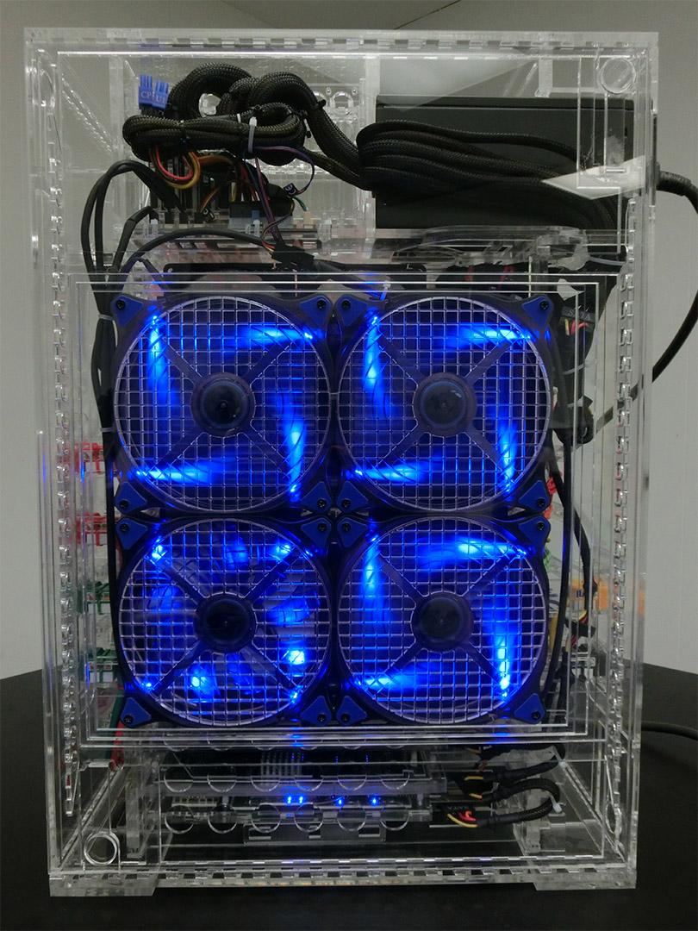
40-Node Pi Cluster
40 Cores @ 700MHz
20GB RAM
5TB Storage (12TB Max)
External Gigabit LAN
Wireless N
Approximate $3000 Cost
http://likemagicappears.com/projects/raspberry-pi-cluster/

Slide 14
Coming
Soon...

Slide 15

Next Month:
UoM Raspberry Jam
Next month’s Jam at the University of Manchester's Computer Science building
Possibly on Saturday 29th March

Slide 16

Raspberry Jamboree:
27th & 28th February
https://www.eventbrite.co.uk/e/ocr-raspberry-jamboree-27-28-february-2014-tickets-8546357385

Slide 17
For Today...

Slide 18
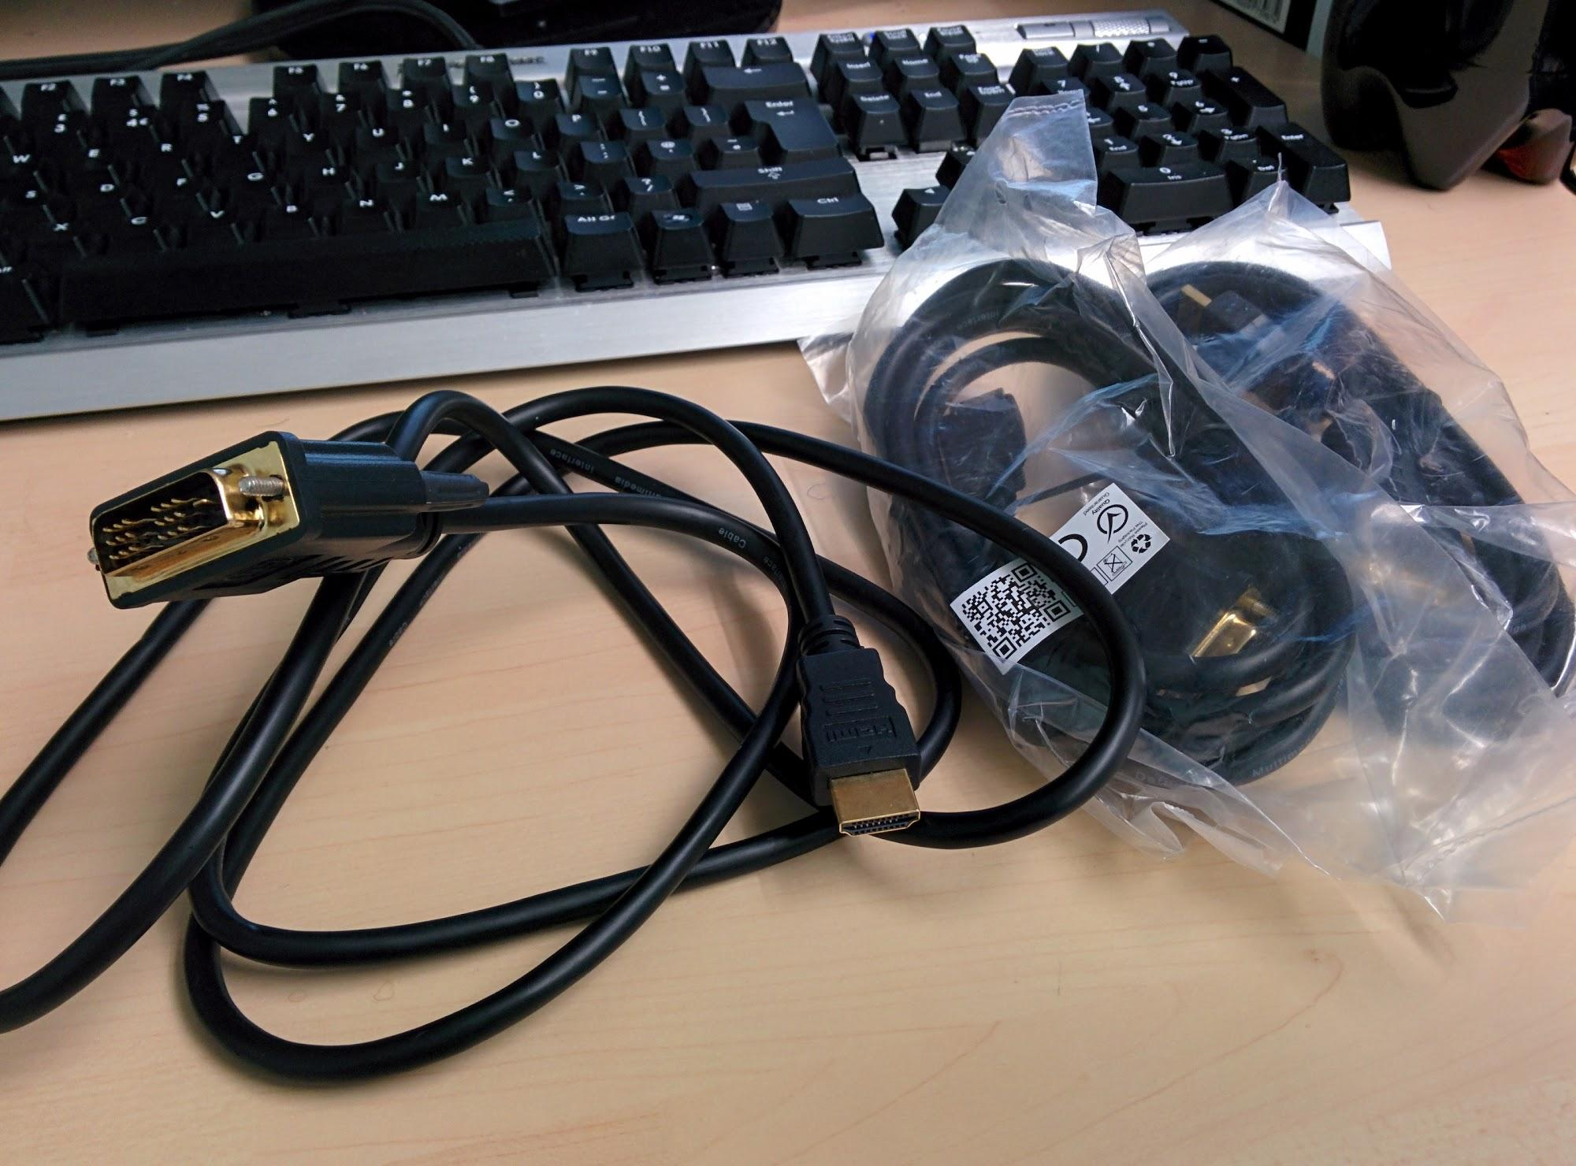

Slide 19
Pizza at 1pm
(Thanks to John for the voucher)

Slide 20
Thanks to
our Sponsors...

Slide 21
Community Sponsors:
Simon Walters Paul Woodhead
Matt Southgate Eddy Cowap
Jenson Grant Elizabeth Howard

